Slide 1

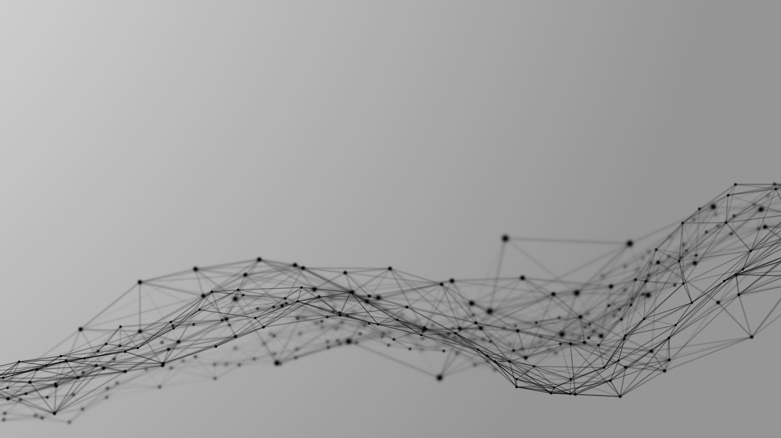
Implementation of Low Dynamic Power & Area Optimized 16-bit Reversible ALU -Utkarsh Mishra

Slide 2
1. Design
Today’s Computer chips are facing a severe problem with power dissipation in addition to that heat generation. Reversible logic reduces power consumption as zero-energy computation has inspired it.
My VLSI project describes Design and Implementation of 16-Bit ALU built using reversible decoder controlled combinational circuits on Spartan3E (XC3S500E-FG320-5) FPGA.

Slide 3
Reversible Gates.
A reversible logic gate is an n-input n-output logic device with one-to-one mapping. This helps to determine the outputs from the inputs and also the inputs can be uniquely recovered from the outputs.
Also in the synthesis of reversible circuits direct fan-Out is not allowed as one–to-many concept is not reversible.

Slide 4
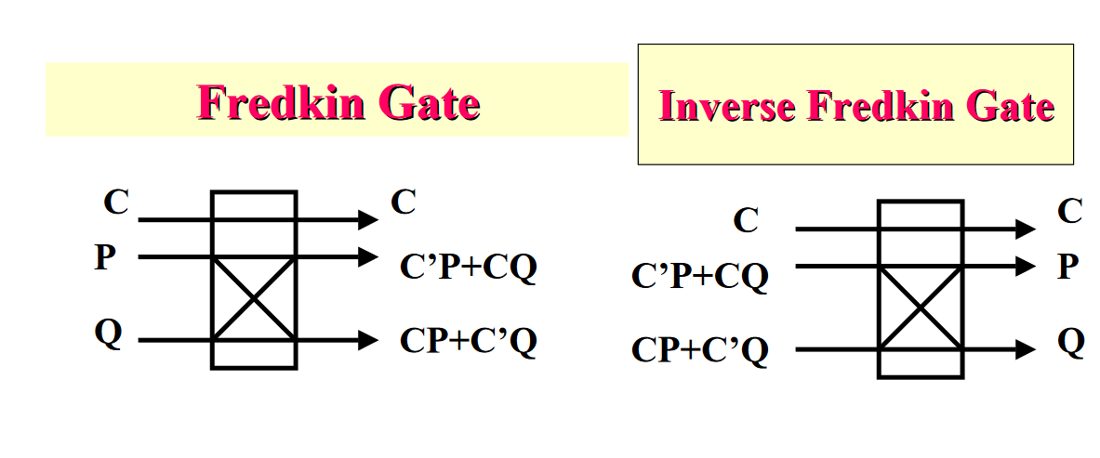

Slide 5
How this works?
Rolf Landauer, 1961. Whenever we use a logically irreversible gate we dissipate energy into the environment.
The loss of information is associated with laws of physics requiring that one bit of information lost dissipates kTln2 of energy.
Landauer/Bennett: all operations required in computation could be performed in a reversible manner, thus dissipating no heat!
And so according to a second law of thermodynamics: ds = dq/T(for reversible process)

Slide 6
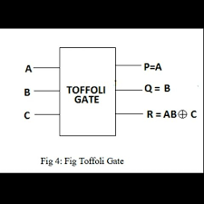
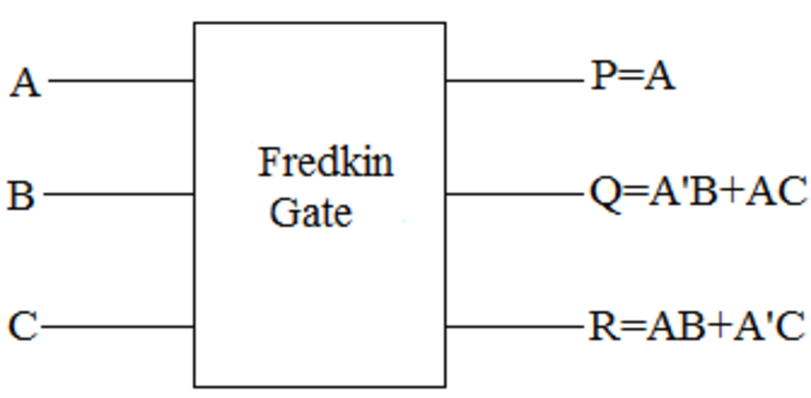
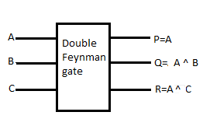
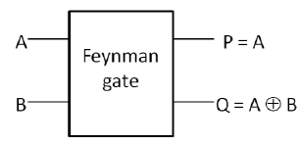
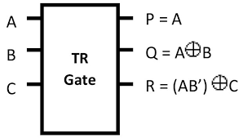
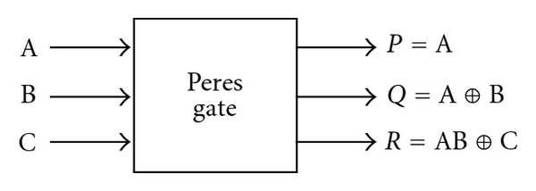
Some reversible gates.

Slide 7
2.Workflow used-
Application Specific integrated circuit (Primary)
Field Programmable gate array (Secondary)

Slide 8
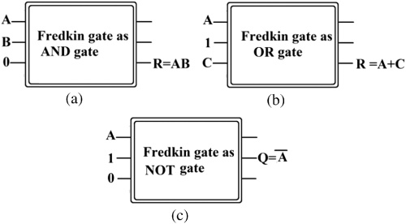

Slide 9
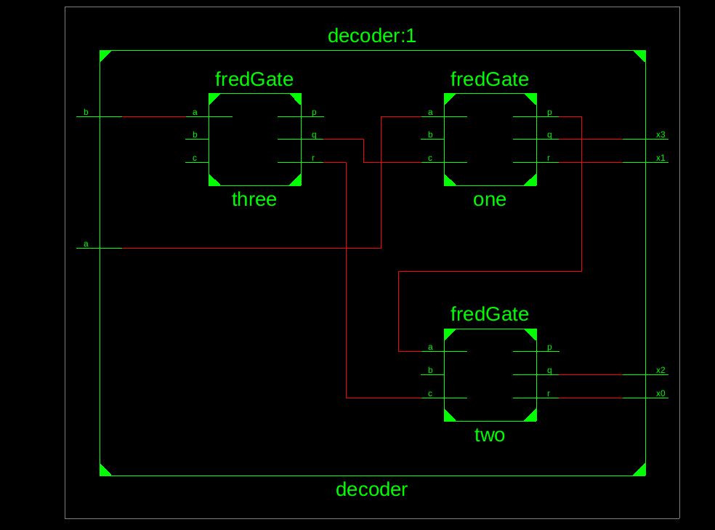
Decoder-

Slide 10
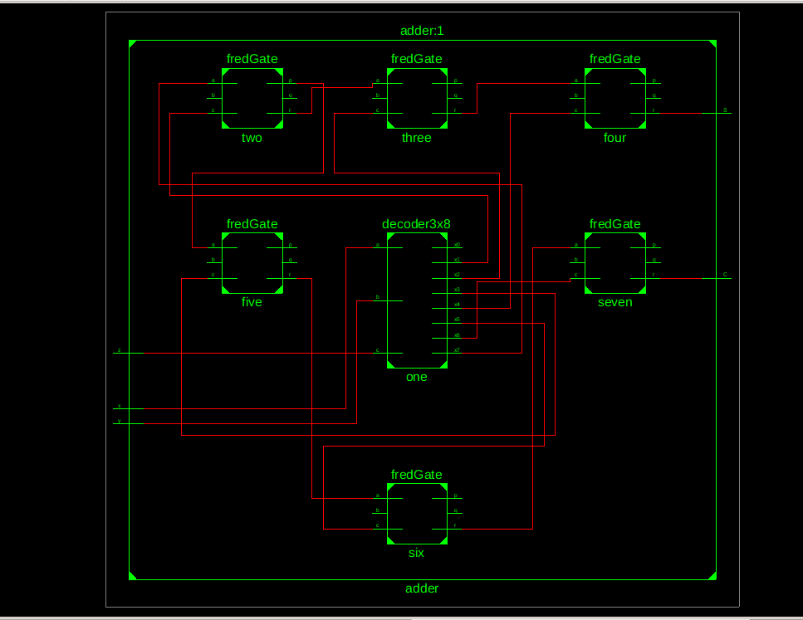
Adder-

Slide 11
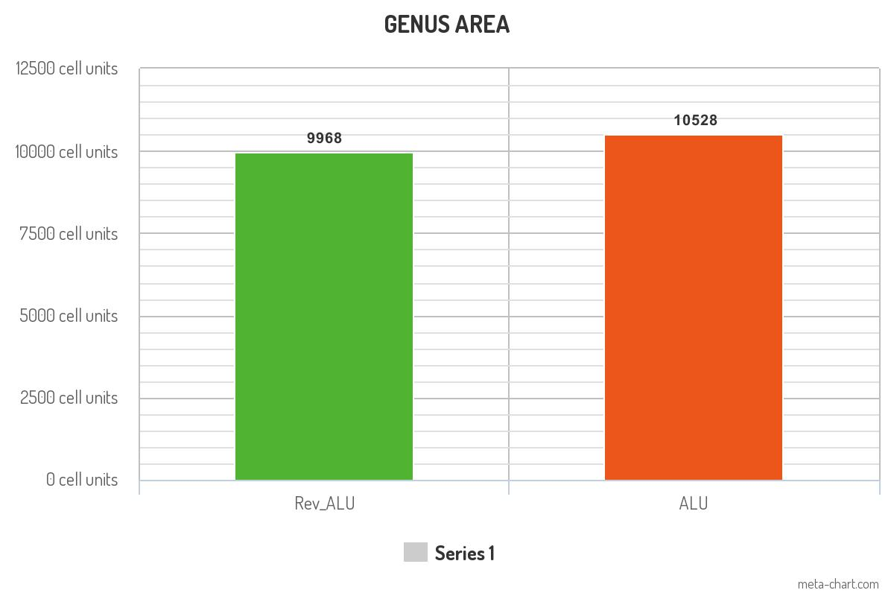
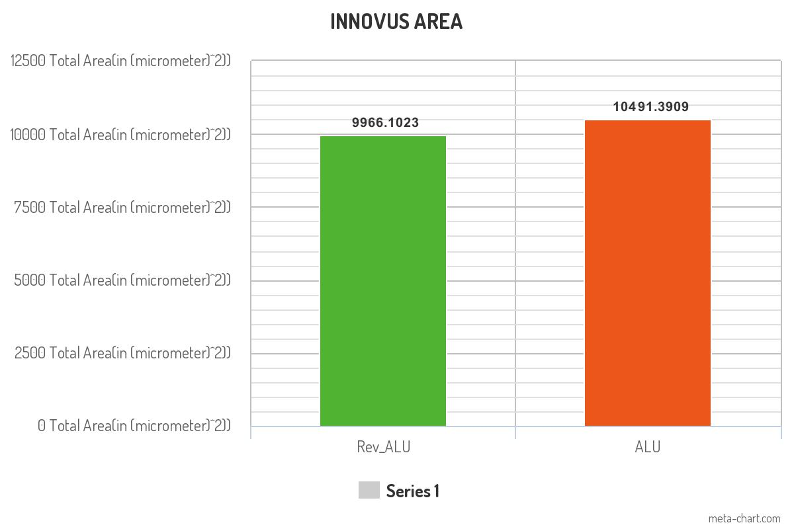
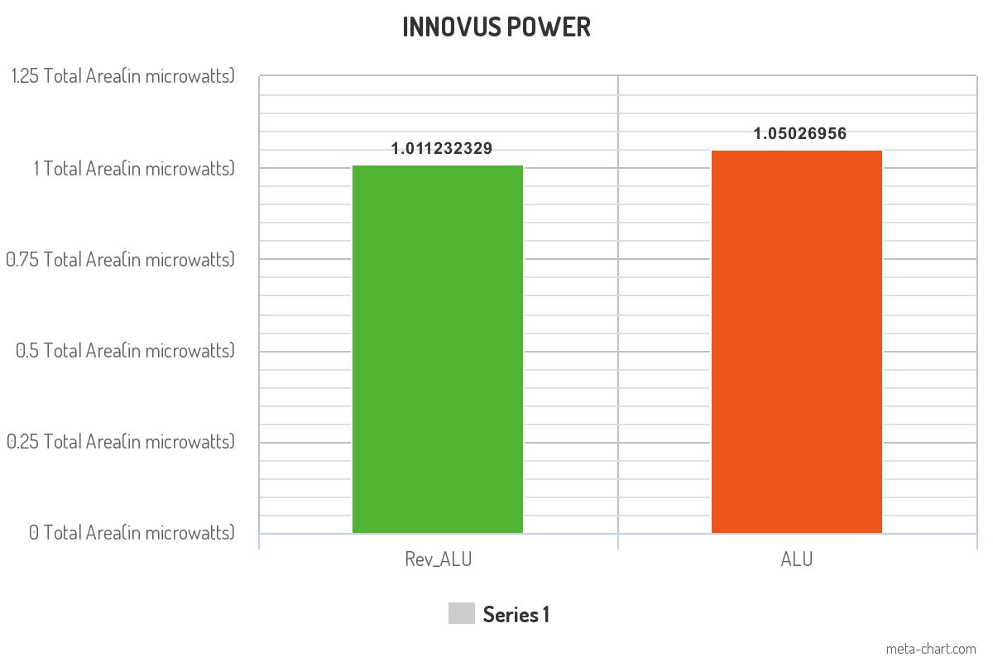
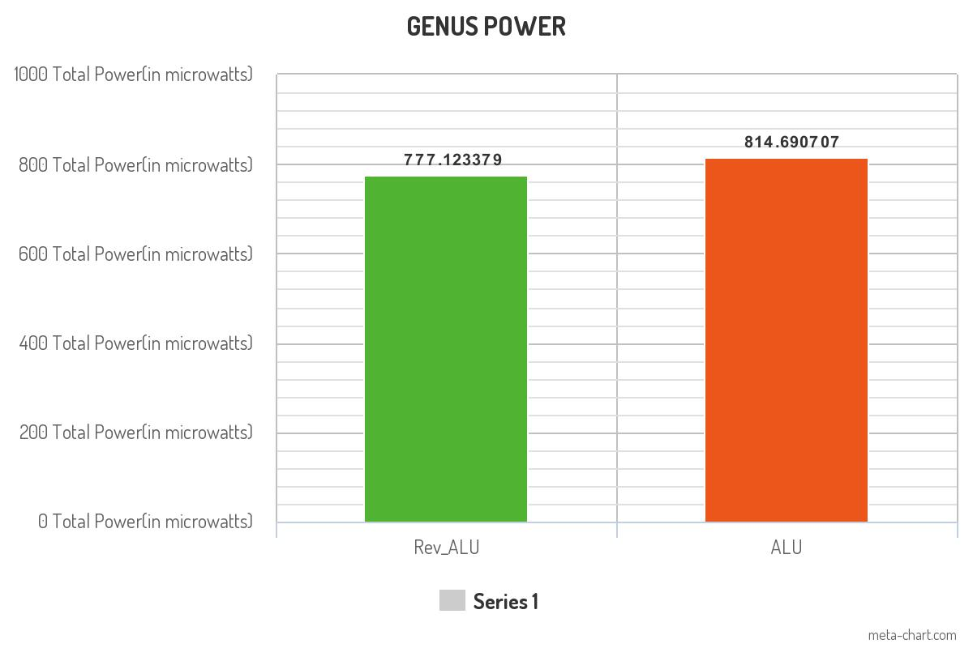
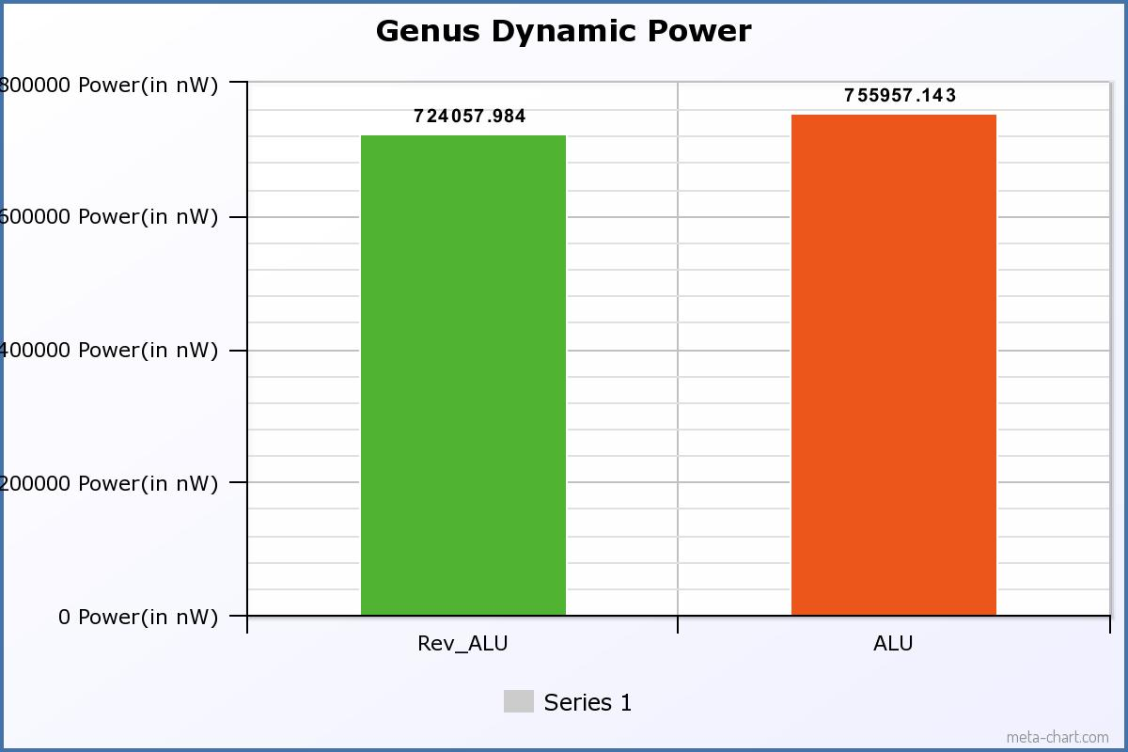
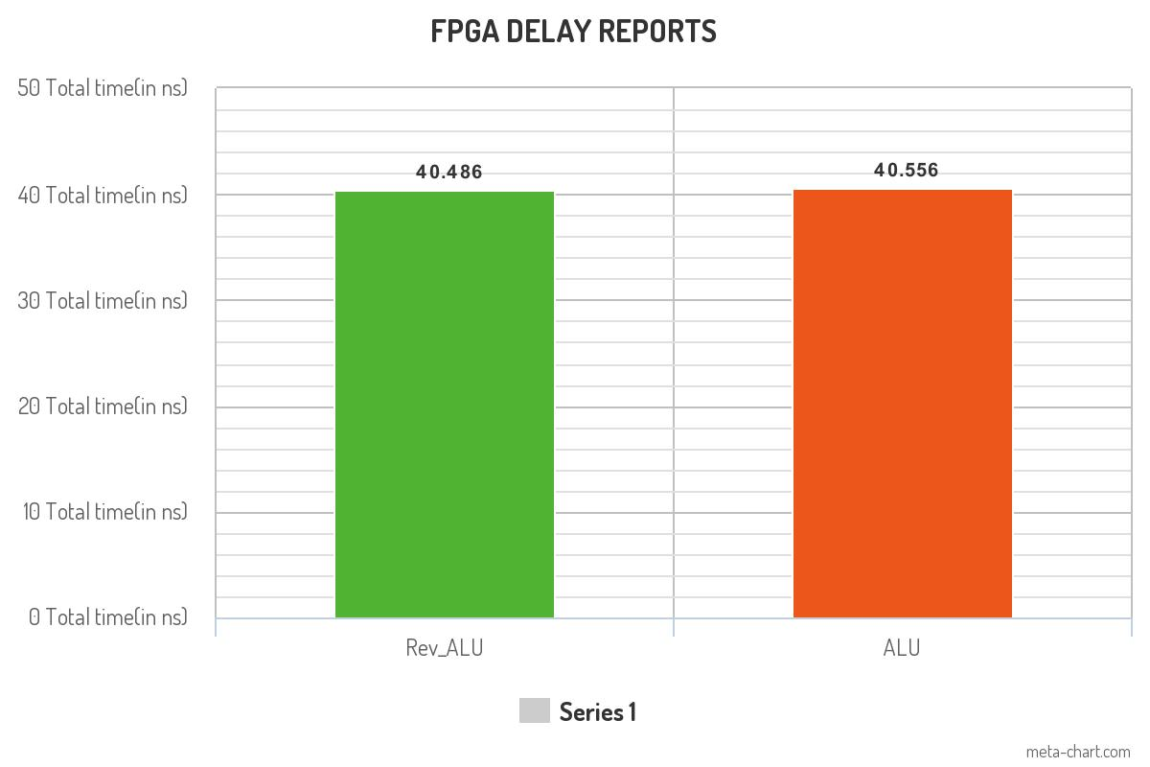
3.Results-

Slide 12
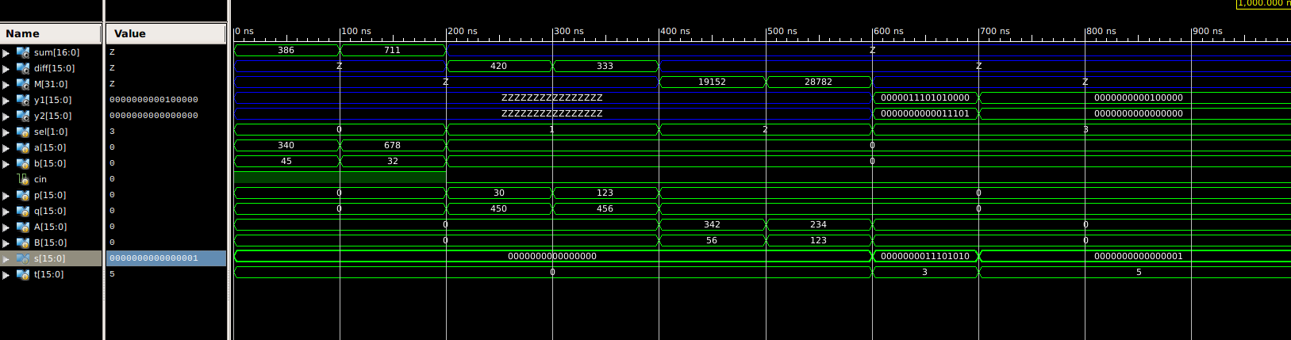
Timing diagrams- ALU

Slide 13
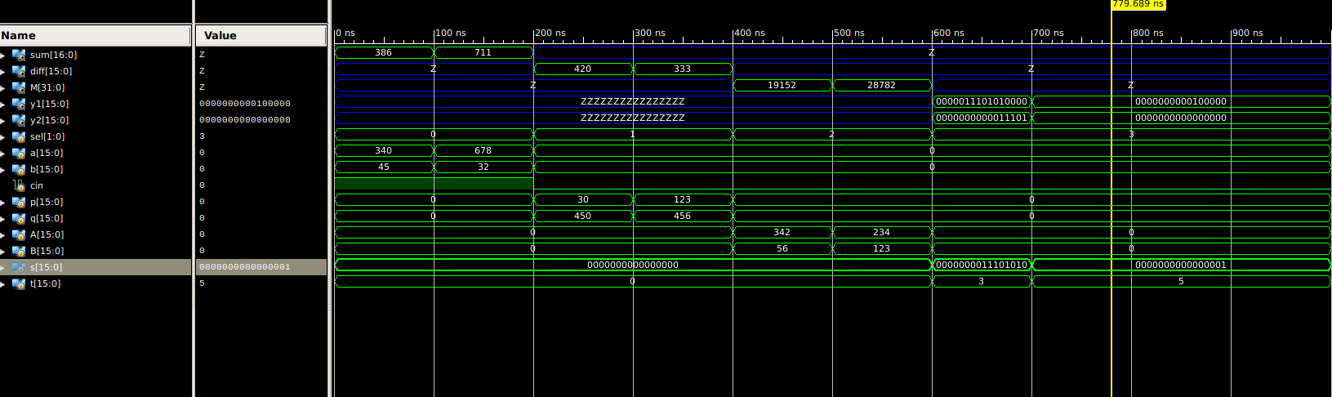
Rev_ALU-

Slide 14
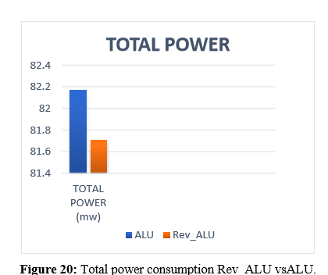
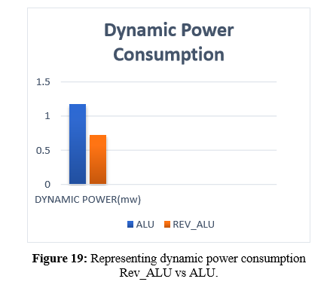
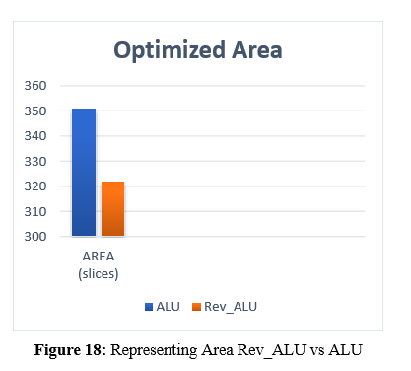
Results to be looked for.

Slide 15
4.Comparison
 | Genus Area (in cell-units) | Genus Power (in microwatts) | Innovus Power (milliwatts) | Innovus Area(micrometer-square)
ALU | 10528 | 814.690707 | 1.05026956 | 10491.3909
Rev_ALU | 9968 | 777.123397 | 1.011232329 | 9966.1023
 | Total Power (microwatts) | Area (Slices)
Rev_ALU(Paper) | 81.71 | 322
ALU ( Paper) | 82.17 | 351

